Slide 1

Introduction to Cloud Computing
Course
Introduction
CS-4037
Muhammad Sudais
muhammad.sudais.v@nu.edu.pk

Slide 2

Course Outline
Introduction to Cloud Computing – History, Benefits & Challenges
Cloud Computing Models and Services
Cloud Security and Virtualization
Overview of popular cloud services
Azure Fundamentals
Azure Compute, Storage, Integration & Networking Services
Resource Management and Scaling in Azure
Cloud Infrastructure, Monitoring and DevOps on Azure
Service-Oriented Architecture (SOA) & Content Delivery Networks (CDN)

Slide 3
Books & References
Textbooks:
Sandeep Bhowmik. 2017. Cloud Computing (1st. ed.). Cambridge University Press.
Jonah Carrio Andersson. 2023. Learning Microsoft Azure. O'Reilly Media, Inc. ISBN 9781098113322.
Reference Books:
Rajkumar Buyya et al. 2013. Mastering Cloud Computing - Foundations and Applications Programming. Morgan Kaufmann Publishers Inc.
K. Chandrasekaran. 2015. Essentials of Cloud Computing. CRC Press.

Slide 4
Marks Distribution (Tentative)
Sessional Exams
20%
Assignments
10%
Quizzes
10%
Project
15%
Class Participation
5%
Final Exam
40%

Slide 5
Project
Students will choose their project topic or select from the list of sample ideas
Work in teams of 6-7
Design, implement, and evaluate cloud applications.

Slide 6
Project Overview
This project focuses on developing a cloud-based application utilizing various Microsoft Azure services. The application will have user authentication, API integrations, and cloud storage, and will be deployed on Azure.

Slide 7
Functional Requirements
Application:
Develop a basic application using ASP.NET, Python, etc. with user authentication.
User Features:
CRUD functionality, register/login.
API Integration:
Expose APIs securely using Azure API Management.
Azure Function:
Add event-driven features.
Cloud Hosting:
Host the application on Azure App Service.
Database:
Use Azure SQL or Cosmos DB.
Storage:
Integrate Azure Blob Storage for file management.

Slide 8
Non-Functional Requirements
Performance:
The application should handle at least 100 concurrent users.
Scalability:
The system must auto-scale based on load.
Availability:
Target 99.95% uptime.
Security:
Ensure encryption and access control.
Cost Optimization:
Use techniques for cost-effective resource management.

Slide 9
Azure Services Overview
Compute:
Azure App Service, Function Apps.
Storage:
Azure Blob Storage, Azure File Storage.
Database:
Azure SQL Database, Cosmos DB.
Security:
Azure Active Directory, Key Vault.
Monitoring:
Azure Monitor, Application Insights.
Networking (Optional):
Azure Virtual Network, Traffic Manager.

Slide 10

Project Milestones
Milestone 1 (Week 2):
Submit proposal with architecture and group details.
Milestone 2 (Week 4):
Submit architecture design and diagram.
Milestone 3 (Week 8):
Initial deployment with authentication and database integration.
Milestone 4 (Week 12):
Complete functionality with monitoring and optimization.
Milestone 5 (Week 16):
Submit full project and present.

Slide 11
Sample Project Ideas
1. E-Commerce Platform
2. Inventory Management System
3. Restaurant Ordering System
4. Learning Management System (LMS)
5. Blog Content Management System
6. Online Bookstore
7. Fitness Tracking App
8. Event Ticketing System
9. Travel Booking System
10. Healthcare Patient Management System
11. Serverless Video Sharing Platform
12. Personal Finance Tracker
13. Serverless Polling and Voting System
14. Real-Time Weather Forecasting Dashboard
15. Employee Timesheet Management System

Slide 12
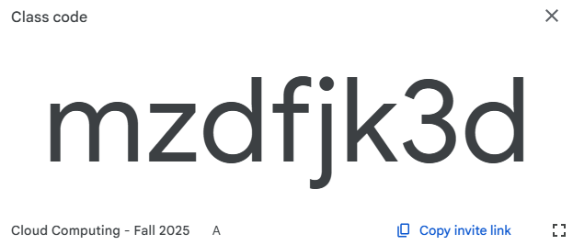

Google ClassRoom Code

